Slide 1

Training an RNN in a perceptual decision making task
BAMB! Summer School
Tutorial 4

Slide 2
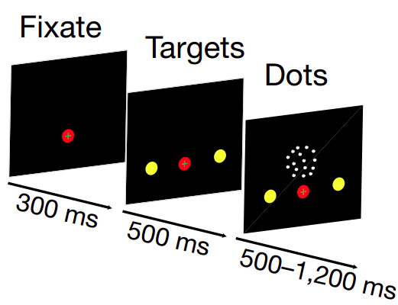
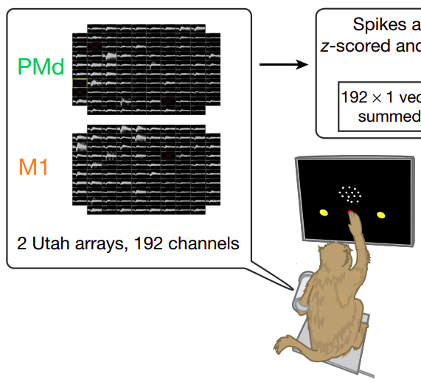
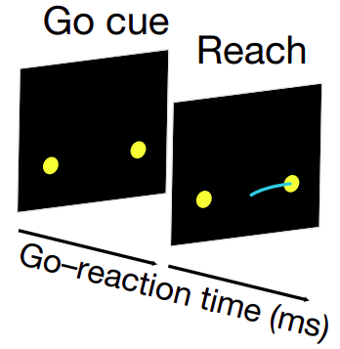
Random Dots Motion task
Peixoto et al. 2021 Nature

Slide 3
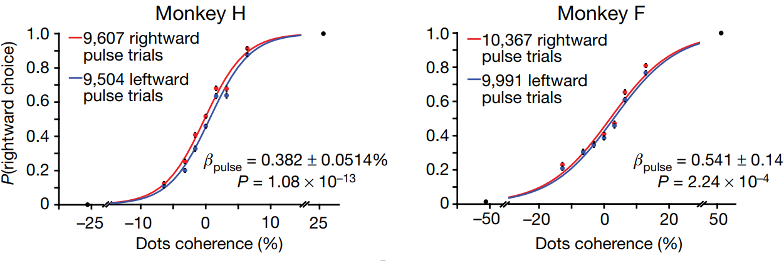
Psychometric curves
Peixoto et al. 2021 Nature

Slide 4
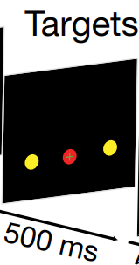
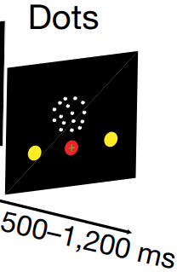
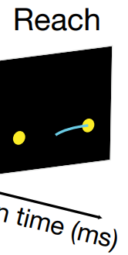
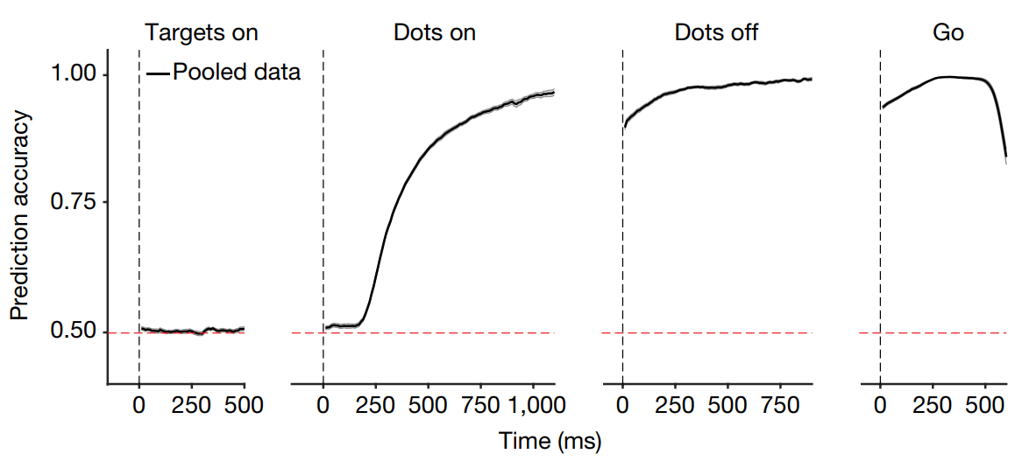
Decoding the choice from the neural activity
Peixoto et al. 2021 Nature

Slide 5
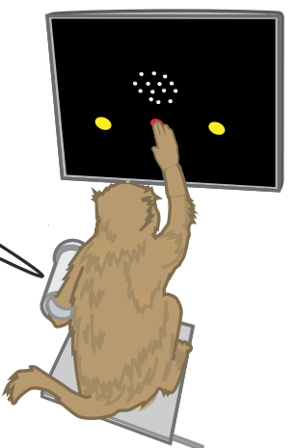
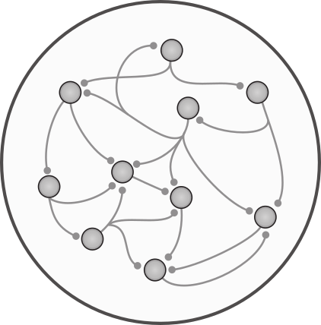

Slide 6
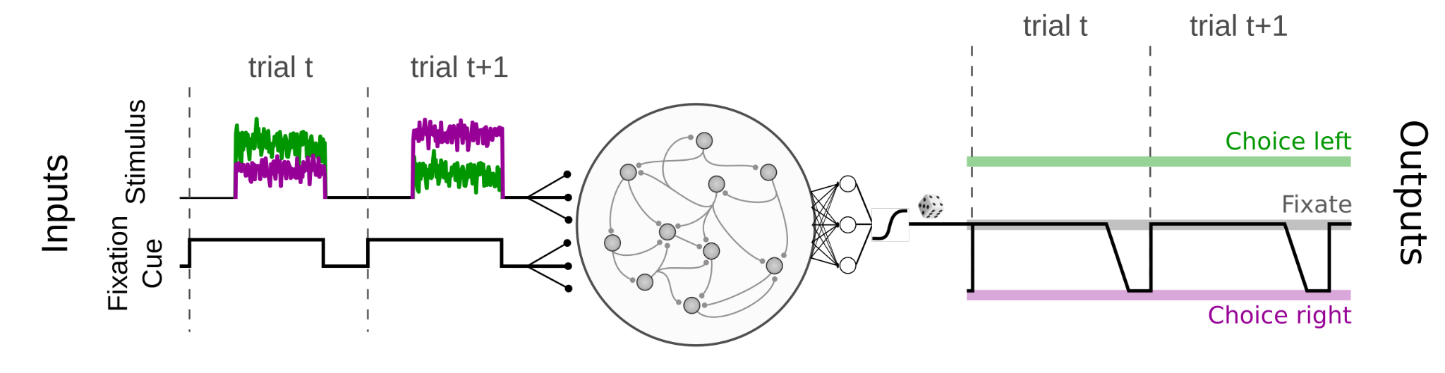

Slide 7
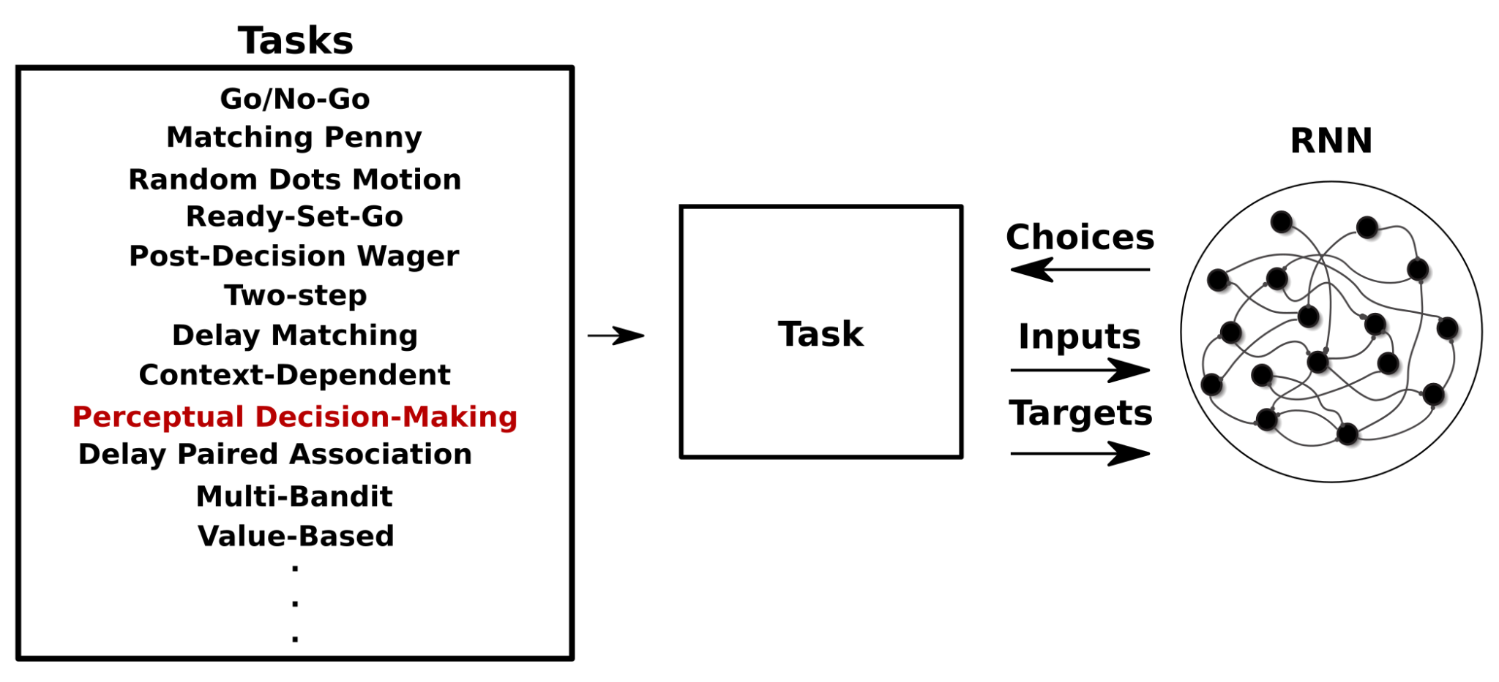
Neurogym

Slide 8
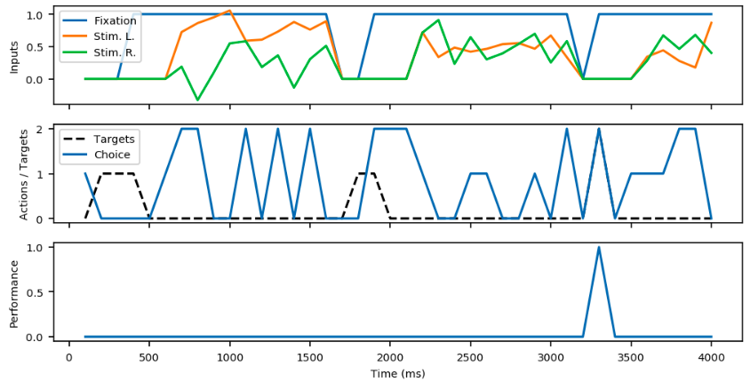
Two-Alternative Forced Choice task

Slide 9
Regarding the inputs
Fixation
Stim. L
Stim. R
100 steps
16 batches
…

Slide 10
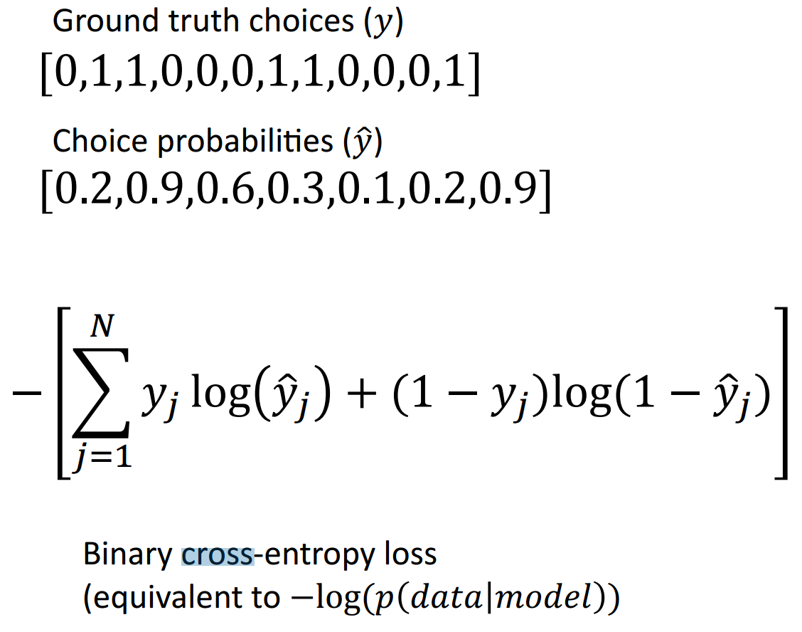
Regarding the training

Slide 11
0. Installs, packages, auxiliary functions.
1. Preparing for the training:
Training parameters.
Define the task (sample dataset).
Define the network.
Define the algorithm to train the network.
Save config.
2. Supervised training of the RNN.
3. Run the trained network (and save the behavioral data).
4. Network analysis:
Behavioral analysis.
General neural analysis.
Stimulus and choice decoding from network activity.

Slide 12
Yang and Wang 2020 Neuron Artificial Neural Networks for Neuroscientists: A Primer
Training an artificial neural network with Pytorch
Neurogym
Recurrent Neural Networks. Lecture 10, CS231 Course Stanford University.​
​
Sequence Models Course, Coursera.​
​
Andrej Karpapthy’s blog. The Unreasonable Effectiveness of Recurrent Neural Networks.​

